Slide 1
A Cross-Platform mobile application to display the important features of Yamaha Bikes
PIP2001 Capstone Project
Review-0
Batch Number: CCS-G04
ROLL NUMBER | NAME OF THE STUDENT
20211CCS0200 | Yaddanapudi Srividhya Nandha
20211CCS0177 | Syed Fuzail Abdullah
20211CCS0127 | Mohamed Huzaif
20211CCS0073 | Ashirwad Bhadola
Under the Supervision of,
Ms. Raesa Raseen
Professor / Associate Professor / Assistant Professor
School of Computer Science and Engineering
Presidency University
Name of the Program: CSE-Cyber Security
Name of the HoD: Dr. Anandaraj S P
Name of the Program Project Coordinator: Dr.Sharmasth Vali Y
Name of the School Project Coordinators: Dr. Sampath A K

Slide 2
Content
Problem Statement
Github Link
Analysis of Problem Statement
Timeline of the Project
References

Slide 3
Problem Statement Number:
Organization: Yamaha Motor Pvt Ltd
Category : Software
Problem Description: Create a cross-platform mobile application to display the important features of Yamaha bikes like Powerful Engine, Electrical Stylish Head Lights, Diamond Type Frame Suspension, etc using Augmented Reality. This is done using Vuforia, an augmented reality software development kit for mobile devices that enables the creation of augmented reality applications. The user scans the bike in their camera through the app, and the features of the bike float at their respective targets. The user can take a screenshot and share through the app. We employ Vuforia with Unity to make a cross platform application, as well as Vuforia Object Scanner to create 3D models of the bikes.Vuforia Object Recognition allows you to detect and track intricate 3D objects.It has been designed to work with consumer products. Object Recognition can be used to build rich and interactive experiences with 3D objects. These experiences could be augmenting a toy with 3D content in order to bring it to life, or overlaying a user manual on top of a product, in our case it is the bike features overlayed on the actual bike.
Difficulty Level: Medium

Slide 4
Github Link
Github Link
https://github.com/YADDANAPUDI-SRI

Slide 5
Analysis of Problem Statement
Problem Statement: The objective is to develop a mobile application that leverages Augmented Reality (AR) to showcase the important features of Yamaha bikes. Users should be able to scan a bike using their device’s camera to view detailed AR overlays of features such as the powerful engine, stylish head lights, diamond-type frame suspension, etc. Additionally, users should be able to take screenshots and share them through the app.
Key Features:
AR-Based Bike Feature Display
3D Object Recognition
Screenshot and Sharing
AR Object Recognition
Cross-platform Development
Real-time Performance
User Interaction
Enhanced User Experience
Marketing Tool

Slide 6
Analysis of Problem Statement (contd...)
Technology Stack Components:
1. Augmented Reality SDK: Vuforia
2. Game Engine: Unity
3. 3D Modeling Tools: Blender / Autodesk Maya
4. Mobile Platform SDKs: Android SDK, iOS SDK (Xcode)
5. Cross-platform Build Support: Unity Build Support for Android/iOS
6. Augmented Reality Libraries: ARCore, ARKit
7. Backend Cloud Services: Firebase / AWS S3
8. APIs:
Screen Capture API
Social Media Sharing API
9. Version Control: Git / GitHub / Bitbucket
10. UI/UX Design: Adobe Photoshop / Adobe Illustrator
11. Testing & Debugging Tools: Unity Profiler, Android Studio, Xcode

Slide 7
Analysis of Problem Statement (contd...)
Software Requirements:
Vuforia SDK
Unity
Vuforia Object Scanner
Vuforia Object Recognition
3D Modeling Software (Blender / Autodesk Maya)
Android SDK
iOS SDK (Xcode)
Unity Build Support for iOS/Android
ARCore / ARKit
Screen Capture API
Social Media Sharing API
Graphics Design Software (Adobe Photoshop/Illustrator)
Cloud Storage Services (Firebase / AWS S3)
Version Control System (Git/GitHub/Bitbucket)
Testing and Debugging Tools (Unity Profiler / Android Studio / Xcode)

Slide 8
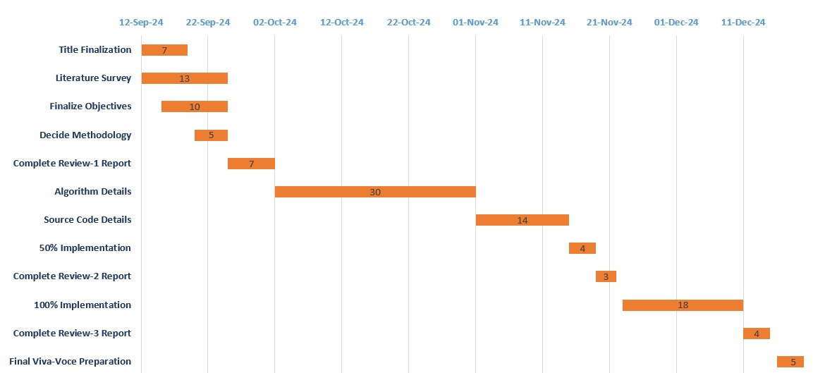
Timeline of the Project (Gantt Chart)

Slide 9
References (IEEE Paper format)
1. Agariadne, Dwinggo, Samala., Natalie-Jane, Howard., Santiago, Criollo-C., Ridho, Dedy, Arief, Budiman., Muhammad, Hakiki., Yayuk, Hidayah. (2024). 1. What Does an IMoART Application Look Like? IMoART—An Interactive Mobile Augmented Reality Application for Support Learning Experiences in Computer Hardware. International journal of interactive mobile technologies, doi: 10.3991/ijim.v18i13.47565
https://typeset.io/papers/what-does-an-imoart-application-look-like-imoart-an-t45a8jvkou
2. Dilun, Sandeepa., Dulsara, Gimhana., Aruna, Lakpriya., Lakshan, Jayaweera., Dileeka, Días., Kasun, T., Hemachandra. (2024). 3. Competitive Virtual Cycling Platform Design for Low Latency Networks. doi: 10.1109/wcnc57260.2024.10570739
https://typeset.io/papers/competitive-virtual-cycling-platform-design-for-low-latency-13x6n9nnr0
3. Michele, Russo., Francesca, Cavallari. (2023). 5. AR-Bicycle: Smart AR Component Recognition to Support Bicycle’s Second Life. doi: 10.1007/978-3-031-36155-5_39
https://typeset.io/papers/ar-bicycle-smart-ar-component-recognition-to-support-1zvgungd4p

Slide 10


